Slide 1

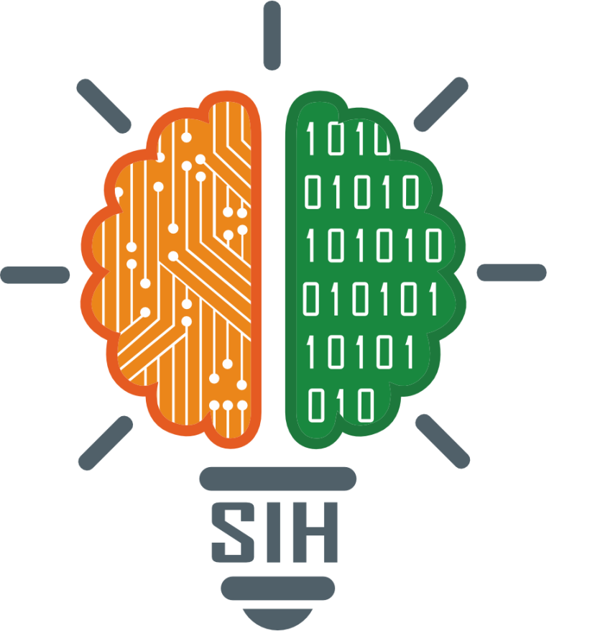
SMART INDIA HACKATHON 2025
TITLE PAGE
Problem Statement ID – SIH25104
Problem Statement Title- Language Agnostic Chatbot
Theme- Smart Education
PS Category- Software
Team ID-
Team Name- Neocoders

Slide 2
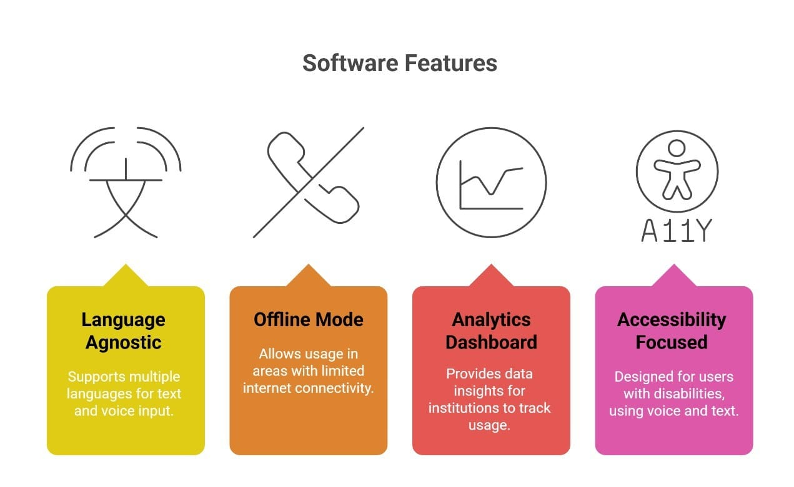
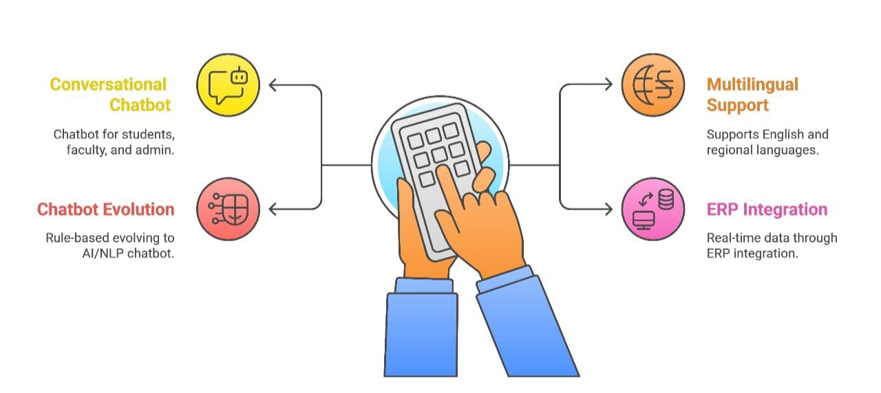
IDEA TITLE MiTra: Ai Driven Student Support System
Neocoders
Proposed Solution :-
Conversational chatbot for student, faculty, and admin.
Multilingual (English + regional languages).
Rule-based → Voice-enabled → AI/NLP chatbot.
ERP integration for real-time data.
Innovation & Uniqueness:
Language agnostic (multi-language text + voice).
Offline mode for low-connectivity areas.
Analytics dashboard for institutions.
Accessibility-focused design (voice + text).

Slide 3
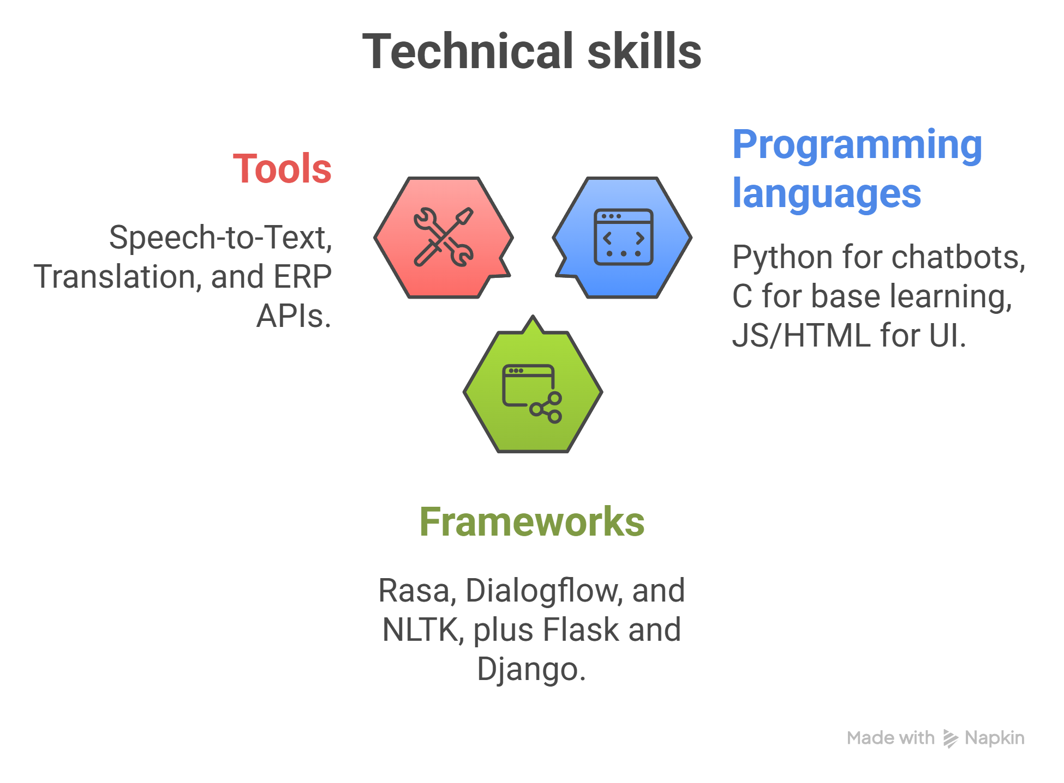

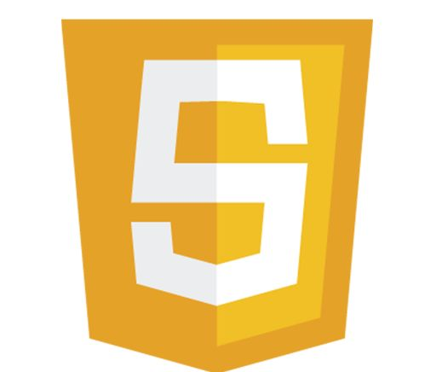

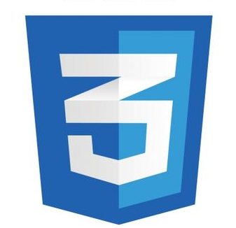
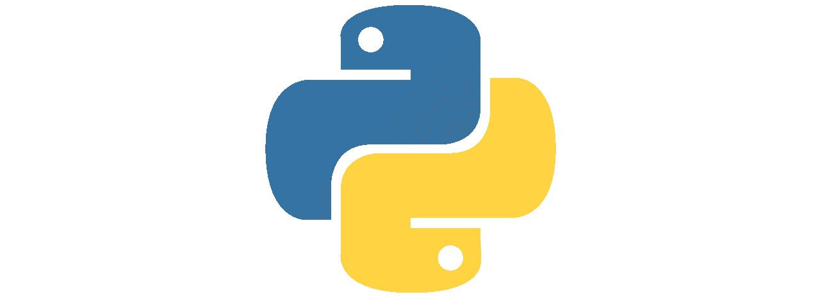

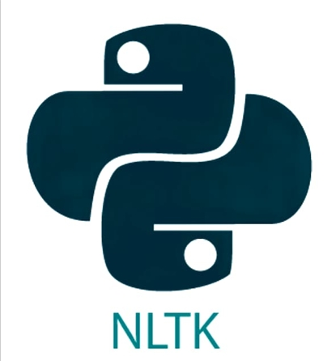


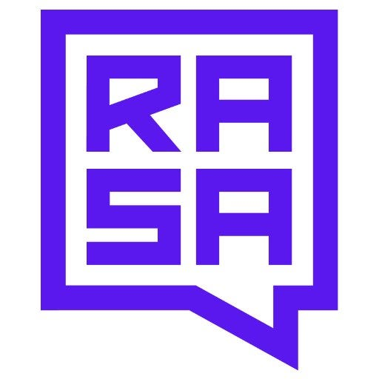
TECHNICAL APPROACH
Neocoders
Methodology (Flow):
1. User Query (text/voice).
2. Language Detection & Translation.
3. Chatbot Engine (Rule-based + NLP).
4. ERP/Database fetch.
5. Response generation in preferred language.
JS, HTML, CSS

Slide 4
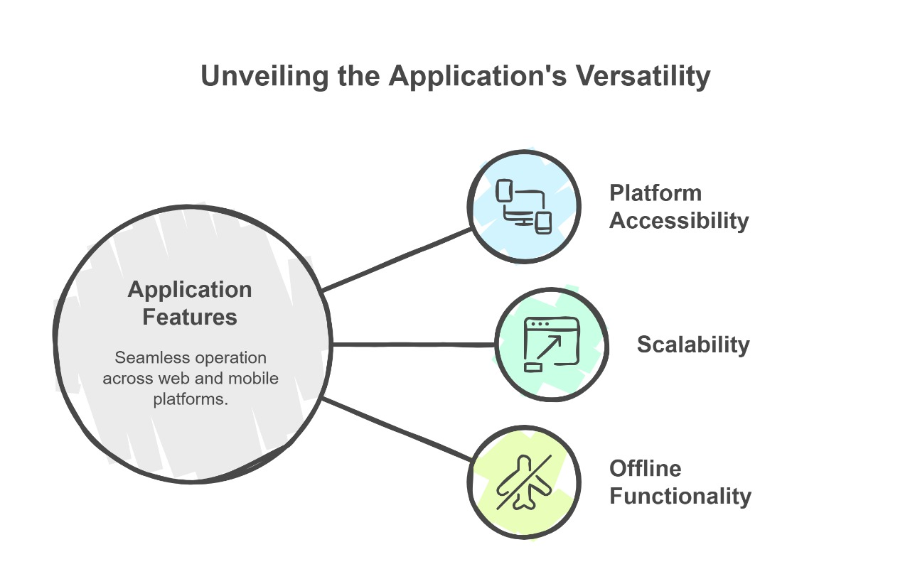
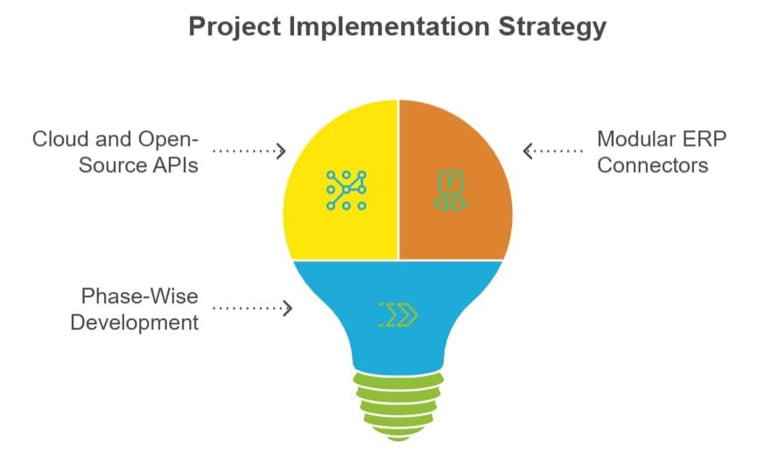
FEASIBILITY AND VIABILITY
Neocoders
Our Challenges :-
Handling multiple languages accurately.
ERP Data Integration.
Training NLP Models with local datasets.
Feasibility:
Works on web & mobile.
Scalable across colleges.
Lightweight offline version possible.
Solutions:
* Use cloud + open-source translation APIs.
* Modular ERP connectors.
* Phase-wise development (Rule-based → AI).

Slide 5
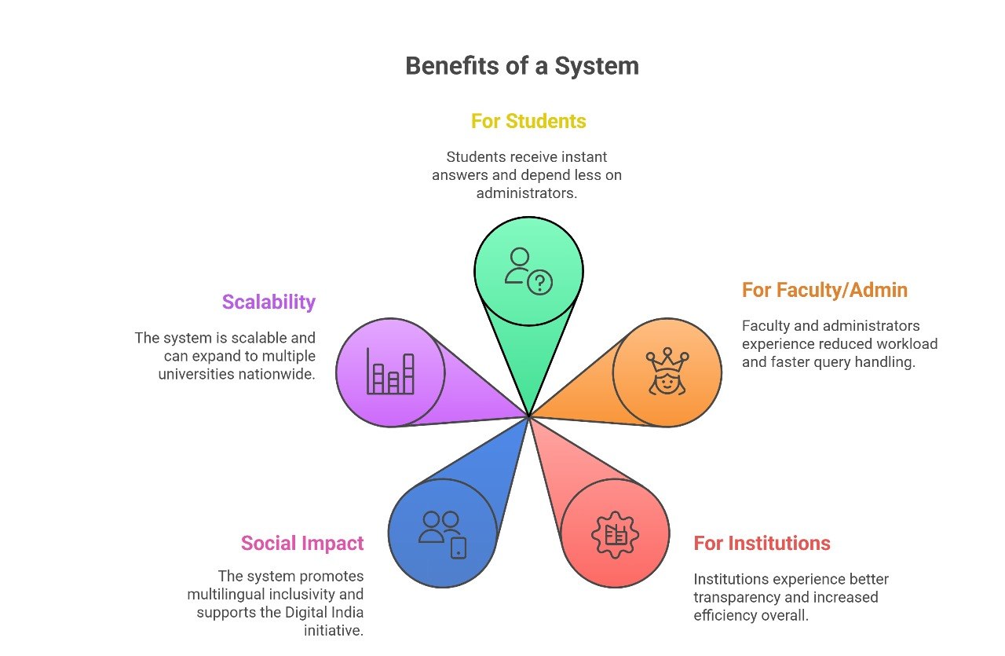
IMPACT AND BENEFITS
Neocoders
Benefit Of This System
Impact & Benefits
For Students: Instant answers, less admin dependency.
For Faculty/Admin: Reduced workload, faster query handling.
For Institutions: Better transparency & efficiency.
Social Impact: Multilingual inclusivity, supports Digital India.
Scalable: Can expand to multiple universities nationwide.

Slide 6
RESEARCH AND REFERENCES
Neocoders
Springer (2024). Generative AI chatbots in higher education: a review of an emerging field.
🔗 https://link.springer.com/article/10.1007/s10734-024-01288-w
ArXiv (2024). Large language model-powered chatbots for internationalizing student support in higher education.
🔗 https://arxiv.org/abs/2403.14702
IndiaAI (Govt. of India). Multilingual Indic Language Translation – AIKosh.
🔗 https://aikosh.indiaai.gov.in/home/use-cases/details/multilingual_indic_language_translation.html
Government’s Digital India & NEP 2020 inclusivity goals.
Existing tools: Rasa, Dialogflow, Microsoft Azure Bot Services.
COMPRAISION WITH EXISTING CHATBOT IN INDIA
Features | IPU AI Assist (Delhi) | Bina (West Bengal) | Ilaya (Tamil Nadu) | Sundarbans College Bots (WB) | NICCI (Rajasthan) | Our Chatbot (Proposed)
Admissions Support | ✅ | ✅ | ✅ | ✅ | ✅ | ✅
Academic Queries (Results, Attendance, Timetable) | ❌ | ❌ | ❌ | ❌ | ❌ | ✅
Multilingual Support | ❌ | Partial | ✅ | ❌ | ✅ | ✅
Voice Interaction (STT/TTS) | ❌ | ❌ | ✅ | ❌ | ✅ | ✅
ERP Integration (College DB) | ❌ | ❌ | ❌ | ❌ | ❌ | ✅
Offline Mode (Low Internet) | ❌ | ❌ | ❌ | ❌ | ❌ | ✅
Admin Dashboard & Analytics | ❌ | ❌ | ❌ | ❌ | ❌ | ✅
Accessibility (for disabled students) | ❌ | ❌ | ❌ | ❌ | ❌ | ✅
Scalable Across Colleges | ❌ | ✅ | ✅ | ❌ | ✅ | ✅

